Slide 1
Letter of Recommendation Web App
Team Number: 58
Members: Somik Datta, Rebecca Soren

Slide 2
Problem Statement
Getting a letter of recommendation can be tedious work for both the student and the teachers. Automation of this process can make life easier for both the students and teachers.

Slide 3
Solution Strategy
Online web portal for requesting and receiving a letter of recommendation.
Students request a letter of recommendation stating your purpose and supporting documents.
Teacher (assigned by the HOD) reviews the details.
HOD accepts or rejects the request after reading the review.
The student can track the progress of the request from their dashboard.

Slide 4
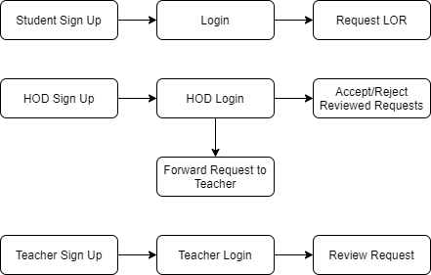
Flow Diagram

Slide 5
User Schema
name: {
first: { type: String, required: true },
last: { type: String, required: true }
},
uniqueid: { type: Number, required: true, unique: true },
password: { type: String, required: true, minlength: 8 },
authorization: { type: Number, default: 2 },
course: { type: Number },
department: { type: Number },
semester: { type: Number }

Slide 6
LOR Schema
title: { type: String, required: true },
content: { type: String },
filesPath: { type: Array, required: true },
department: { type: Number, required: true },
createdBy: { type: mongoose.Schema.Types.ObjectId, ref: "User" },
createdOn: { type: Date },
review: { type: String },
reviewedBy: { type: mongoose.Schema.Types.ObjectId, ref: "User" },
isreviewed: { type: Boolean },
reviewedOn: { type: Date },
acceptedBy: { type: mongoose.Schema.Types.ObjectId, ref: "User" },
isaccepted: { type: Boolean },
acceptedOn: { type: Date },
rejectedBy: { type: mongoose.Schema.Types.ObjectId, ref: "User" },
isrejected: { type: Boolean },
rejectedOn: { type: Date },
isassigned: { type: Boolean },
assignedTo: { type: mongoose.Schema.Types.ObjectId, ref: "User" }

Slide 7
Thank You
Team Number: 58
Members: Somik Datta, Rebecca Soren

